Slide 1
Machine Instructions and Programs

Slide 2
Memory Locations and addresses
Memory Operations
Instructions and Instruction sequencing
Addressing modes
Basic Input Output Operations

Slide 3
The different ways in which the location of an operand is specified in an instruction are referred to as addressing modes

Slide 4
Addressing Modes
Implied
  AC is implied in “ADD M[AR]” in “One-Address” instr.
Immediate
  The use of a constant in “MOV 5, R1”, i.e. R1 ← 5
Register
  Indicate which register holds the operand
  MOV R1,R2
Instruction
Opcode
Mode
...

Slide 5
Direct Address(Absolute Mode)
  Use the given address to access a memory location
  Ex: Move LOC, R2
Both the modes are used
LOC Uses Direct mode.
R2 Uses Register mode.

Slide 6
Indirect Mode
  The effective address of the operand is the contents of a register or memory location whose address appears in the instruction
  Indirection is denoted by placing the name of a register or memory location given in the instruction in parenthesis

Slide 7
Indirect Address
  Memory Indirect
    Indicate the memory location that holds the address of the memory location that holds the data
    ADD (A),R0
Memory
100
A
101
0 1 0 4
102
103
104
1 1 0 A

Slide 8
Register Indirect
  Indicate the register that holds the address of the operand
    MOV R1, (R2)
Memory
R1
110A
100
R2
102
101
102
1 1 0 A
103
104

Slide 9
Indirect Addressing in LOOP ex.
Move N,R1
Move #Num1,R2 //Addr of 1st no Clear R0
Loop Add (R2),R0
Add #4,R2
Decrement R1
Branch>0 Loop
Move R0,Sum
Registers
R0
R1
R2
0
5
1000
Memory
1000
1004
1008
100C
1020 Sum
10
20
30
40
50
F0

Slide 10
Index Mode
The effective address of the operand is generated by adding a constant value to the contents of the register.
  EA=X+[Ri] [X CONSTANT; R i Index Register ]
  Index mode is symbolically represented as X(R i)
  The value of Ri does not change.
The constant X may be given either as an explicit number or as a symbolic name representing a numerical value.
If X is shorter than a word, sign-extension is needed.
  The value of X defines the offset / displacement.
  This is used basically in Lists and Arrays.

Slide 11
Index mode
  EA = Index Register + Relative Addr
Memory
Useful with “Auto increment” or “Auto decrement”
X = 2
+
100
R = 100
101
Could be Positive or Negative
(2’s Complement)
102
1 1 0 A
103
104

Slide 12
Example:
Consider n students and with their ID, 3 marks Test1,Test2 and Test3 are entered.
.
.
.
.
.
n
N
Student ID
List
Student 1
Test 1
List + 4
Test 2
List + 8
Test 3
List+12
Student ID
List+16
Student 2
Test 1
Test 2
The Problem represents a 2 Dimensional array with n rows and 4 columns.
Test 3

Slide 13
Program
R0
R1
R2
R3
R4
1000
0
0
0
2
Move #List, R0
Clear R1
Clear R2
Clear R3
Move N,R4
Add 4(R0),R1
Add 8(R0),R2
Add 12(R0),R3
Add #16,R0
Decrement R4
Branch>0 Loop
Move R1,Sum1
Move R2,Sum2
Move R3,Sum3
Memory
1000
1004
1008
100C
1020 1024
1028
102C
Sum1
Sum2
Sum3
1
20
30
40
2
25
35
45
Loop
//Test1 marks
//Test2 marks
//Test3 marks
//Next stud
Note: The Register R0 value is not changed indexed addr modes.

Slide 14
Variations of Indexed mode.
The Index mode facilitates access to an operand whose location is defined relative to a reference point within the data structure in which the operand appears.Variations are:
(Ri ,Rj): A reg: is used to contain the offset value.
    The EA = Ri + Rj
    The second register is called the base register.
    More flexibility : Both reg contents can be changed.
X(Ri,Rj) :The constant is also used other than the Registers.
    The EA = X + Ri +Rj
    Used mostly in 3D array.

Slide 15
Base Register
  EA = Base Register + Relative Addr
Memory
Could be Positive or Negative
(2’s Complement)
AR = 2
+
100
0 0 0 5
BR = 100
101
0 0 1 2
102
0 0 0 A
Usually points to the beginning of an array
103
0 1 0 7
104
0 0 5 9

Slide 16
Relative Addressing
Relative mode – the effective address is determined by the Index mode using the program counter in place of the general-purpose register.
X(PC) – note that X is a signed number
  EA=X+PC
This location is computed by specifying it as an offset from the current value of PC.
Branch>0 LOOP
  Used to specify target addr in Branch instr
Branch target may be either before or after the branch instruction, the offset is given as a singed num.
    eg: The LOOP in previous example. [-16(PC):- X=-16,PC=1016;
    EA=1016+-16]

Slide 17
Memory
Relative Address
  EA = PC + Relative Addr
0
1
Program
PC = 2
2
+
100
Data
AR = 100
101
102
1 1 0 A
Could be Positive or Negative
(2’s Complement)
103
104

Slide 18
Additional Modes
Basic modes: Register, Immediate, Direct, Indirect, Index mode.
Other modes:
  Auto increment mode : The EA of the operand is the contents of the register in the instr. After accessing the operand the contents are automatically incremented.
      (Ri)+ {Increments by 1 for byte sized operand, 2 for 16-bit operand, 4 for 32-bit operand}
      Ex: Add (R2)+,R0
  Auto decrement mode: The contents of the reg is first automatically decremented and then used as the EA of operand.
      -(Ri)
      Mainly used in Stacks.

Slide 19
Move
N,R1
Move
#NUM1,R2
Initialization
Clear
R0
LOOP
Add
(R2)+,R0
Decrement
R1
Branch>0
LOOP
Move
R0,SUM

Slide 20
Addressing Modes
Name
Assem
bler
syn
tax
Addressing
function
The different ways in which the location of an operand is specified in an instruction are referred to as addressing modes.
Immediate
#V
alue
Op
erand
=
V
alue
Register
R
i
EA
=
R
i
Absolute
(Direct)
LOC
EA
=
LOC
Indirect
(R
i
)
EA
=
[R
i
]
(LOC)
EA
=
[LOC]
Index
X(R
i
)
EA
=
[R
i
]
+
X
Base
with
index
(R
i
,R
j
)
EA
=
[R
i
]
+
[R
j
]
Base
with
index
X(R
i
,R
j
)
EA
=
[R
i
]
+
[R
j
]
+
X
and
offset
Relative
X(PC)
EA
=
[PC]
+
X
Autoincremen
t
(R
i
)+
EA
=
[R
i
]
;
Incremen
t
R
i
Autodecrement
−
(R
i
)
Decremen
t
R
i
;
EA
=
[R
i
]

Slide 21
Memory Locations and addresses
Memory Operations
Instructions and Instruction sequencing
Addressing modes
Basic Input Output Operations

Slide 22
I/O
The data on which the instructions operate are not necessarily already stored in memory.
Data need to be transferred between processor and outside world (disk, keyboard, etc.)
I/O operations are essential, the way they are performed can have a significant effect on the performance of the computer.

Slide 23
Program-Controlled I/O Example
Read in character input from a keyboard and produce character output on a display screen.
Rate of data transfer (keyboard, display, processor)
Difference in speed between processor and I/O device creates the need for mechanisms to synchronize the transfer of data.
A solution: on output, the processor sends the first character and then waits for a signal from the display that the character has been received. It then sends the second character. Input is sent from the keyboard in a similar way.

Slide 24
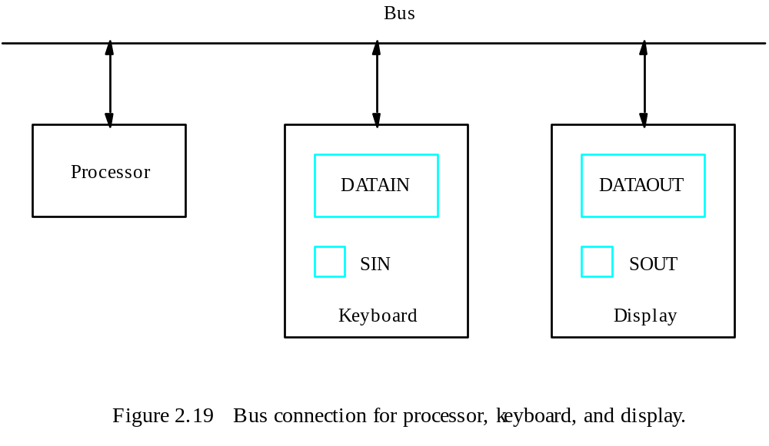

Slide 25
Keyboard
  Striking a key stores the character code in an 8-bit buffer register – DATAIN
  A status control flag, SIN, is set to 1
  Processor reads the content of DATAIN and SIN is cleared to 0.
Display
  A buffer register DATAOUT and status control flag, SOUT
  When SOUT is 1, the display is ready to receive a character
DATAIN, DATAOUT,SIN,SOUT are part of a circuitry known as device interface

Slide 26
Machine instructions that can check the state of the status flags and transfer data:
READWAIT Branch to READWAIT if SIN = 0
Input from DATAIN to R1
WRITEWAIT Branch to WRITEWAIT if SOUT = 0
Output from R1 to DATAOUT

Slide 27
Memory-Mapped I/O
  Some memory address values are used to refer to peripheral device buffer registers.
  No special instructions are needed.
  Eg. MoveByte DATAIN,R1
  MoveByte R1,DATAOUT
  Also use device status registers.
  Bit b3 in registers INSTATUS and OUTSTATUS corresponds to SIN and SOUT
  Eg. READWAIT Testbit #3, INSTATUS
  Branch=0 READWAIT
  MoveByte DATAIN, R1

Slide 28
Thank You

